Slide 1

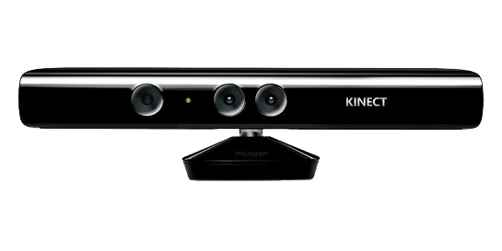

Recognizing ongoing human actions with the help of
Lyubomir Yanchev
yanchev.lyubomir@gmail.com

Slide 2
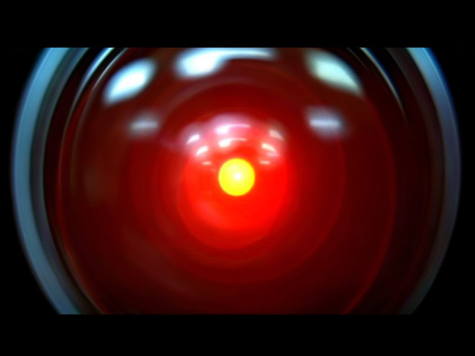
you wish..

Slide 3
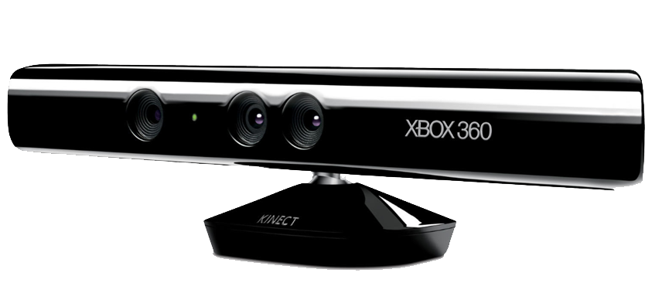


Slide 4
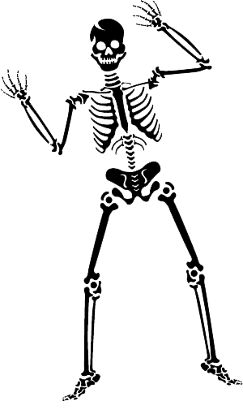
Meet Skelly!

Slide 5
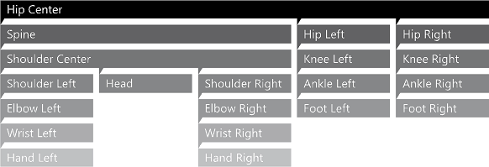

Slide 6
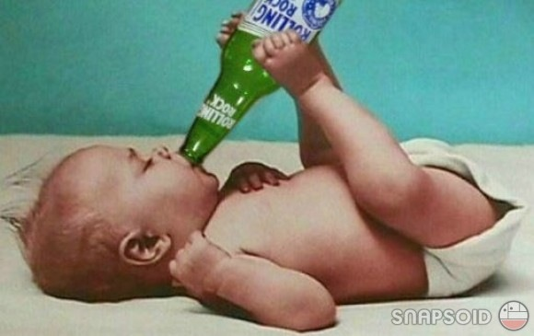
What is a human action?!
Getting beer from the fridge
Going to the fridge
Opening the fridge
Getting the beer
Closing the fridge
reach after the handle
walking
reach after the beer…

Slide 7
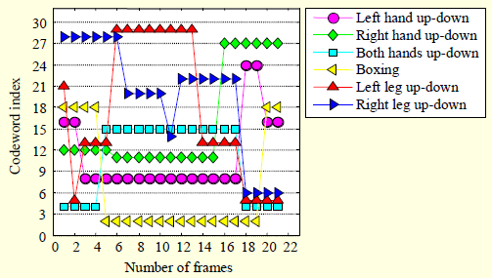

Slide 8
What benefits the human action recognition?

Slide 9
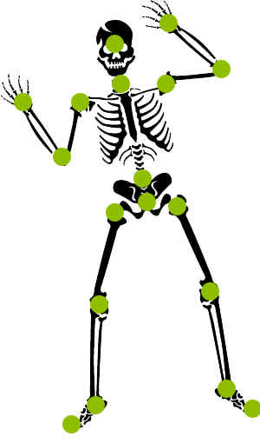
What benefits the human action recognition?
Thanks, Skelly!

Slide 10
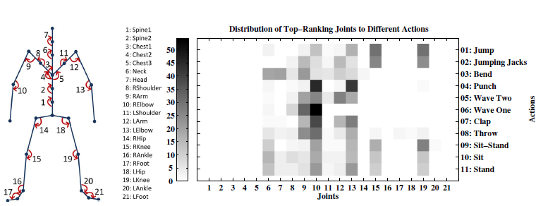
Sequence of the most informative joints

Slide 11
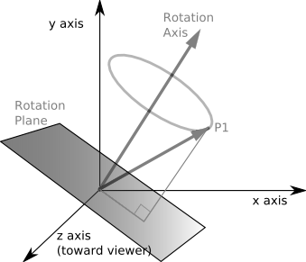
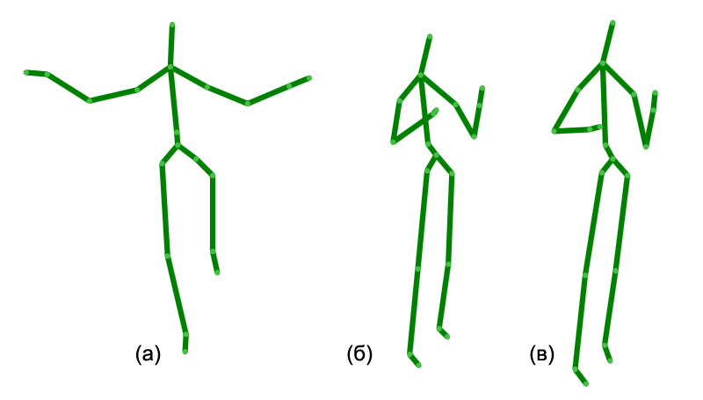

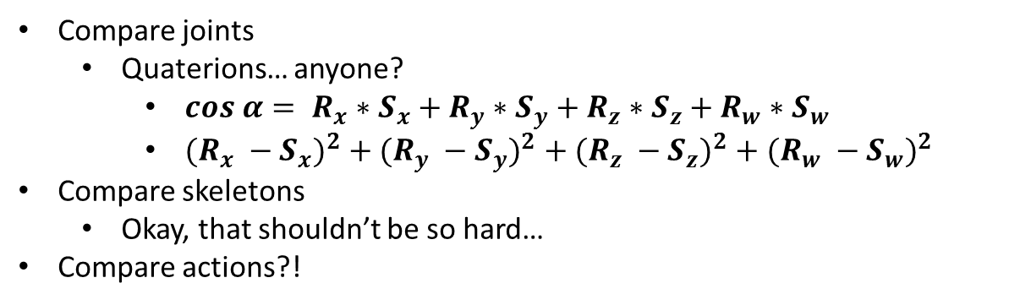
Burn!
Calculations...
Compare joints
Quaterions… anyone?
$cos α= R_{x}∗S_{x}+R_{y}∗S_{y}+R_{z}∗S_{z}+R_{w}∗S_{w}$
${(R_{x} −S_{x})}^{2}$ $+$ ${(R_{y} −S_{y})}^{2}$ $+$ ${(R_{z} −S_{z})}^{2}$ $+$ ${(R_{w} −S_{w})}^{2}$
Compare skeletons
Okay, that shouldn’t be so hard…
Compare actions?!

Slide 12
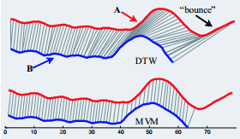
How do we compare actions?
Hidden Markov models
Used most commonly
Dynamic time warping aah?
Elastic matching
?!
Neural networks
They’re “OK” for everything

Slide 13
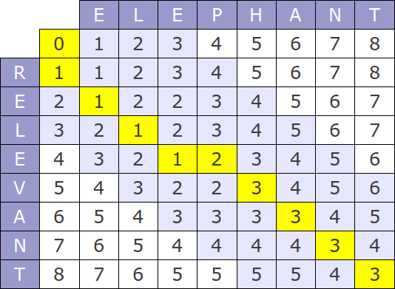
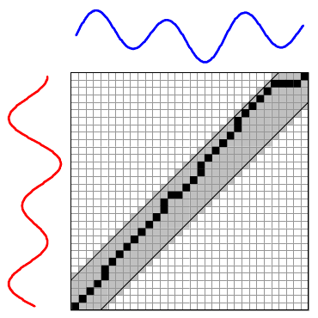
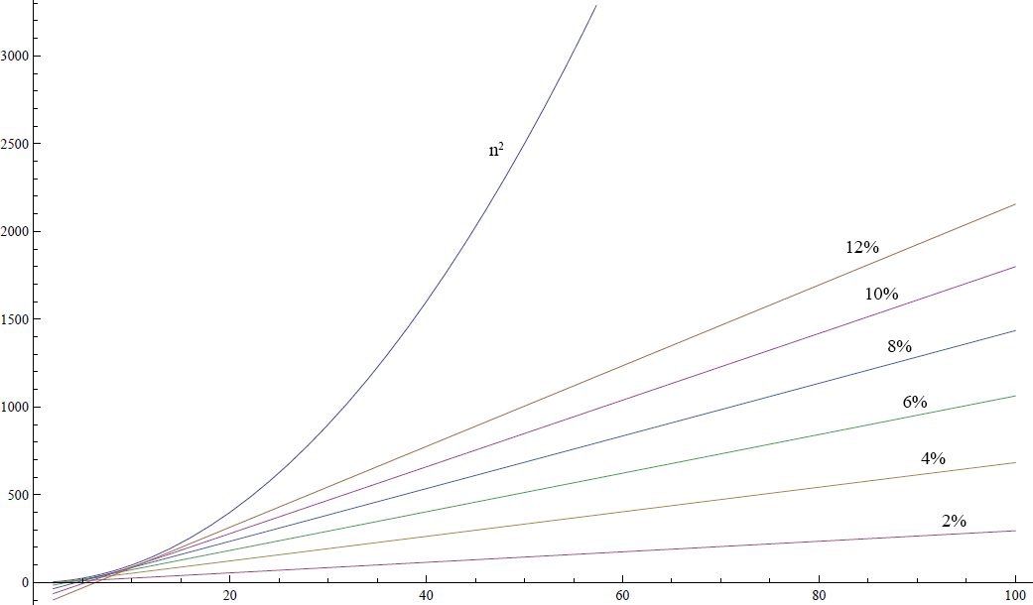
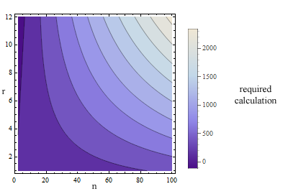
Sakoe-chiba band

Slide 14
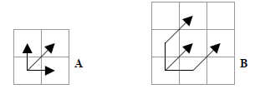
Optimization
N | Width in % | Calculations | Optimization
100 | 2% | 295 | 97.05%
100 | 4% | 683 | 93.17%
100 | 6% | 1063 | 89.37%
100 | 8% | 1435 | 85.65%
100 | 10% | 1799 | 82.01%
100 | 12% | 2155 | 78.45%
Step patterns

Slide 15
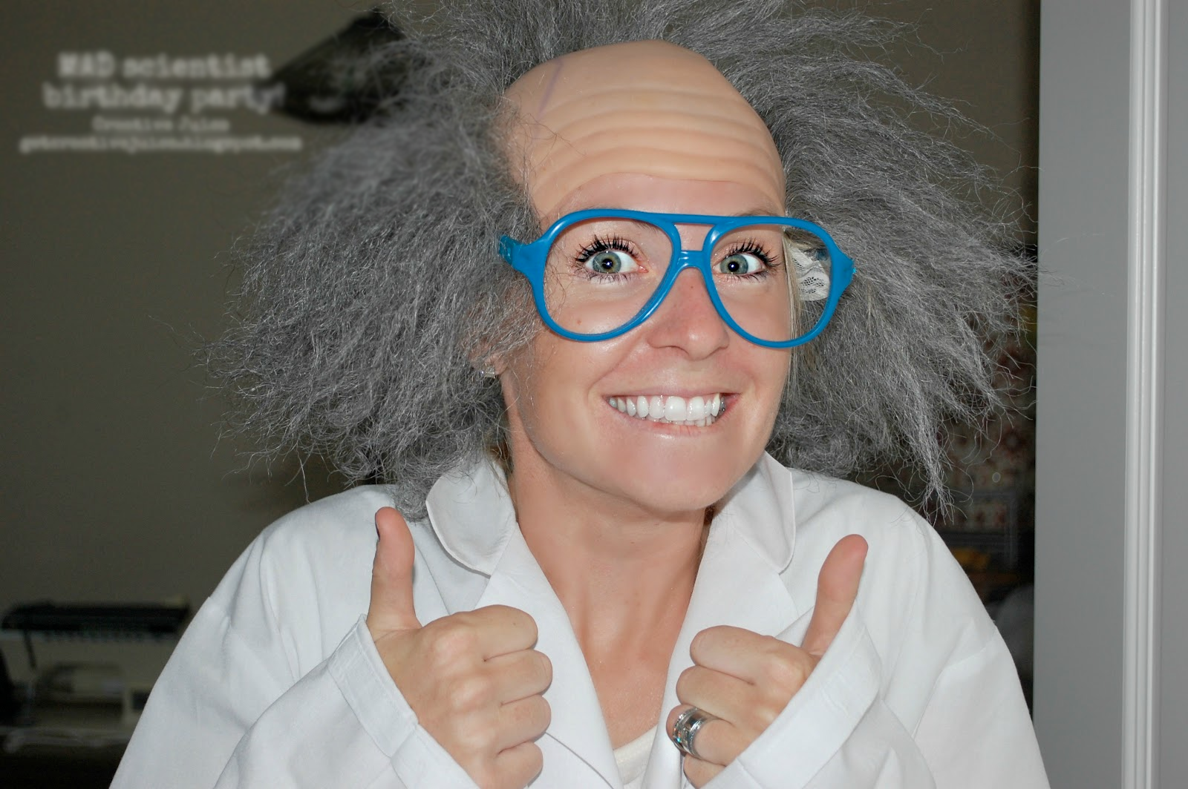
Demonstration At last…

Slide 16
But where?

Slide 17
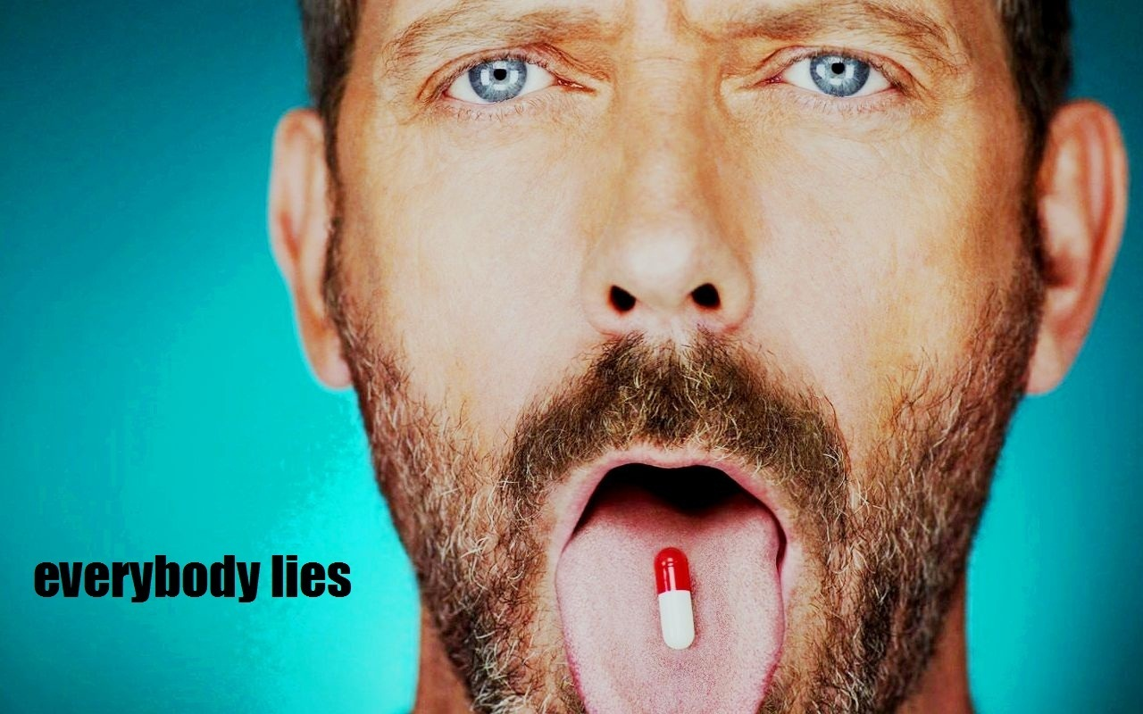
Medicine

Slide 18
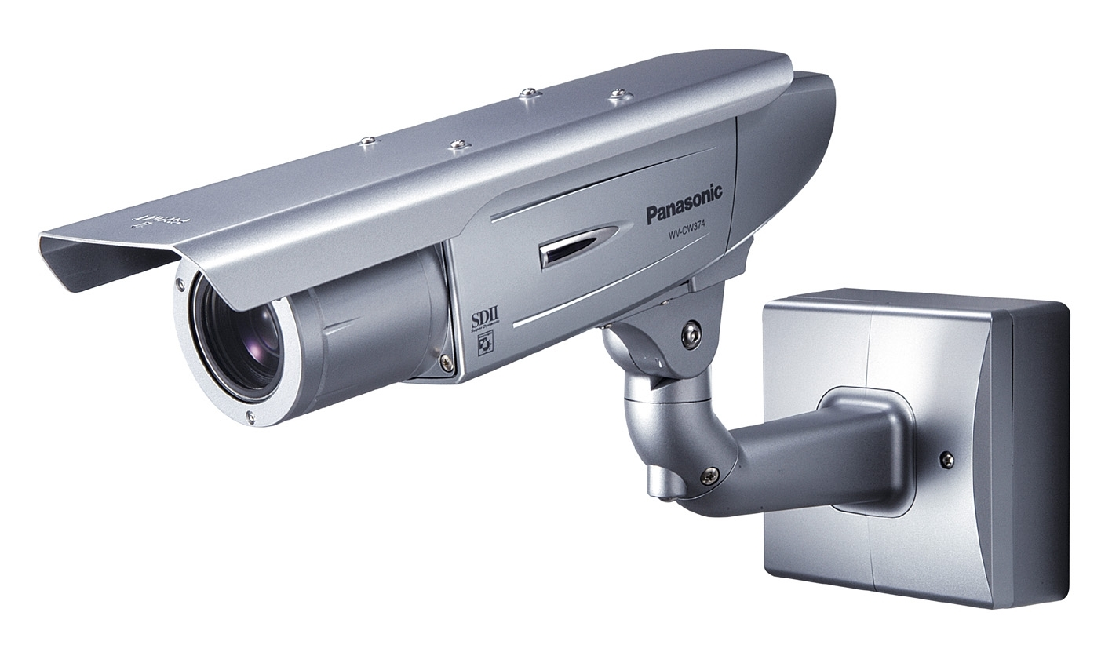
Video surveillance

Slide 19
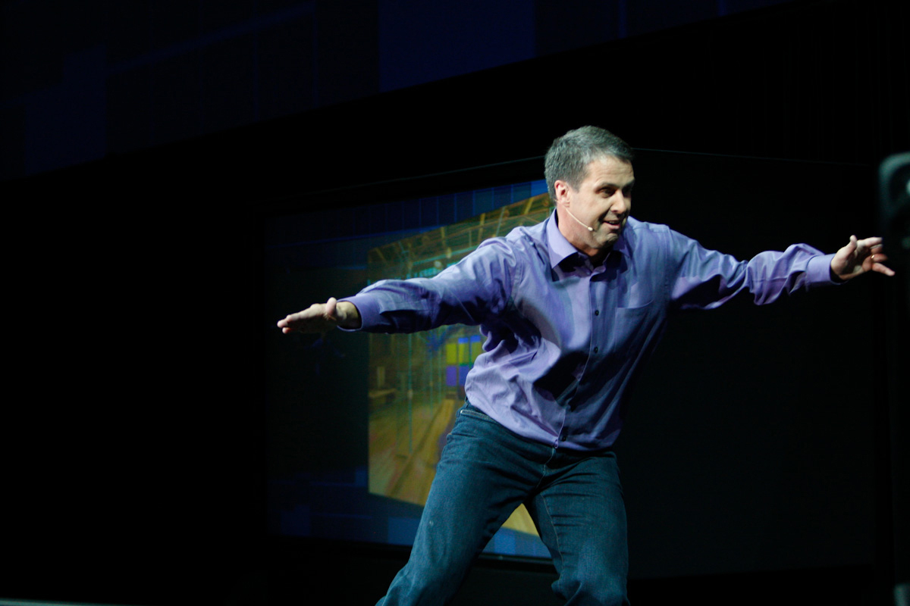
Natural user interface

Slide 20
Used literature...
Not all of them
A Method For Human Action Recognition (Osama Masoud and Nikos Papanikolopoulos)
Qualitative Recognition of Ongoing Human Action Sequences (Yasuo Kuniyoshi, Hirochika Inoue)
Human Action Recognition from Boosted Pose Estimation (Li Wang, Li Cheng)
Action Recognition Based on A Bag of 3D Points (Wanqing Li, Zhengyou Zhang, Zicheng Liu)
Human Activity Recognition Using Body Joint-Angle Features and Hidden Markov Model (Md. Zia Uddin, Nguyen Duc Thang, Jeong Tai Kim, and Tae-Seong Kim)
Distributed Recognition of Human Actions Using Wearable Motion Sensor Networks (Allen Y. Yang , Roozbeh Jafari, S. Shankar Sastry and Ruzena Bajcsy)
Evaluation of local spatio-temporal features for action recognition (Heng Wang, Muhammad Muneeb , Alexander Kläser, Ivan Laptev, Cordelia Schmid)
Human action recognition with pose similarity (Shiquan Wang, Kaiqi Huang, Tieniu Tan)
Sequence of the Most Informative Joints (SMIJ): A New Representation for Human Skeletal Action Recognition (Ferda Ofli, Rizwan Chaudhry, Gregorij Kurillo, Ren´e Vidal and Ruzena Bajcsy)
Activity Recognition Using a Combination of Category Components and Local Models for Video Surveillance (Weiyao Lin, Ming-Ting Sun, Radha Poovendran, Zhengyou Zhang)
Expandable Data-Driven Graphical Modeling of Human Actions Based on Salient Postures (Wanqing Li, Zhengyou Zhang, Zicheng Liu)
Does Human Action Recognition Benefit from Pose Estimation? (Angela Yao, Juergen Gall, Gabriele Fanelli, Luc Van Gool)

Slide 21

Thanks!
Lyubomir Yanchev
yanchev.lyubomir@gmail.com

